Slide 1
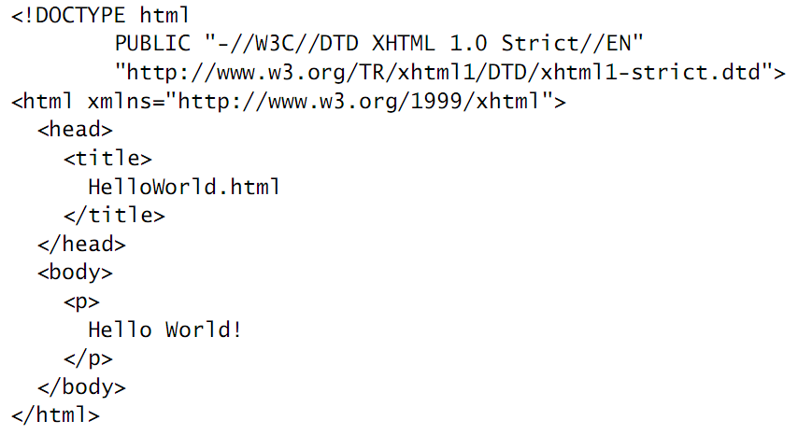
Let’s review the HTML!
Mark up => is contained in tags consisting of angle bracket tag delimiters (< and >) plus the text contained between these delimiters
Character data => everything outside of markup tag intended to be displayed by browser

Slide 2
First tag is <!DOCTYPE is a special markup information called the document type declaration.
Primary function is to identify the particular version of HTML (eg. XHTML 1.0 Strict Version)
Document Instance everything below the <html.
Element => start tag and corresponding end tag, along with all the documents of the tag.
Content => the portion between the tag

Slide 3
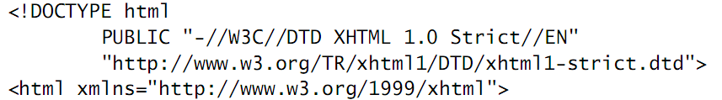
The first word after DOCTYPE keyword is the name of the root element.
For HTML document, the root is always named HTML.
The first tag in the document instance of HTML file must be a start tag for root element.
In order to strictly conform with the XHTML 1.0 standard, the html start tag must also contain the xmlns="..." string.

Slide 4
HTML’s History & Version
HTML initially defined by a single person, Tim Berners-Lee in 1990.
Lee working at CERN(physics research center) developed with science & engineering interests in mind.
elements in use as of November 1992 included the title and paragraph, hyperlinks, headings, simple lists, glossaries, text with monospace fonts and any white space retained, and address blocks
no facility for producing tables or ﬁll-in forms, much less for including images within a document.

Slide 5
The War Years
Marc Andreessen and Eric Bina of NCSA (national center for supercomputer applications) developed MOSAIC as a part of large project.
By February 1993 they had publicly released a preliminary version of their browser for UNIX.
By September of the same year an initial release of this browser, along with Windows and Macintosh versions, was made available
In addition to displaying images within documents, the NCSA Mosaic browser could play video clips as well as sounds, user-friendly interface, multimedia support

Slide 6
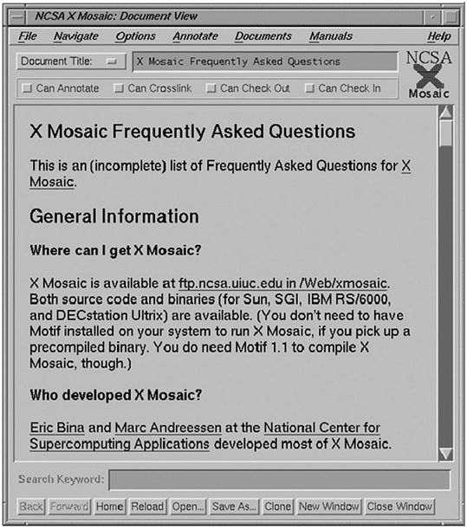

Slide 7
Many individuals involved in the early Mosaic development at NCSA left to begin the company that became Netscape Communications.
This included Andreessen, became the Netscape CEO
The company soon had hundreds of employees
After an initial delay, Microsoft deployed a similarly large development team to work on its Internet Explorer browser, initiating what became known as the “browser wars” between Netscape and Microsoft

Slide 8
During the period from 1993 through 1997, HTML was being deﬁned operationally by the elements that browser software developers choose to implement.
This led to signiﬁcant HTML differences, not only between the latest products of each manufacturer, but also between newer and older versions of browsers from the same manufacturer.
In October 1994, Tim Berners-Lee launched World Wide Web Consotium (W3C)
W3C released its HTML 4 recommendation in December of 1997. The current version of this recommendation, HTML 4.01,

Slide 9
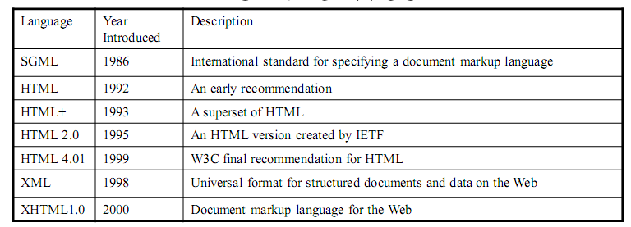

Slide 10
HTML vs XHTML
XHTML 1.0 is a reformulation of HTML 4.01 as an XML
markup language
Controlled by World Wide Web Consortium (W3C)
Why XHTML
– HTML has few syntax rules, leading to sloppy and sometime
ambiguous documents
– HTML processors do not even enforce the few syntax rule that do
exist in HTML
– XHTML syntax is much more strict, leading to clean and clear
documents in a standard form
– The syntactic correctness of XHTML documents can be validated
– But, we are seeing the resurrection of HTML5 now

